Slide 1
Fabric Defect Detection System
reporter:eleven group
time:4.4

Slide 2
01. Project Outline
CONENT
02. Technology Introduction
03. Project Development Plan
04. Project Team Organization
05. Project Risk

Slide 3
01
Project Outline

Slide 4
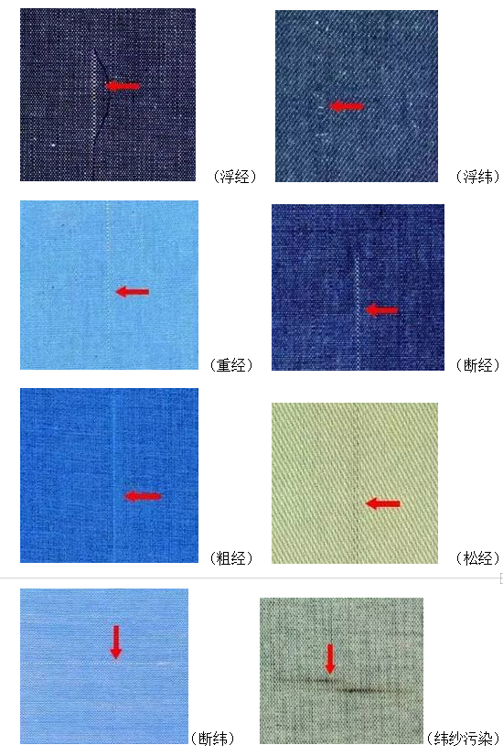
Project Outline
Artificial intelligence is a strategic emerging industry in China. With the continuous improvement and upgrading of various industries, industrial informatization has gradually been put on the agenda. AI plays an important role in informatization, which can replace human to complete some complex and time-consuming tasks in the past.
Fabric defect detection is an important part of production and quality management in the textile industry, and intelligent detection of fabric defects has been a technical bottleneck that has puzzled the industry for many years. Currently, almost all of the detection are manual tasks, which are susceptible to subjective factors and lack consistency; And long-term work under strong light has a huge impact on testers’ health. Using advanced technologies such as AI and CV to achieve intelligent detection of fabric defects is undoubtedly of great value.

Slide 5

Picture

Slide 6

Picture

Slide 7
02
Technology Introduction

Slide 8
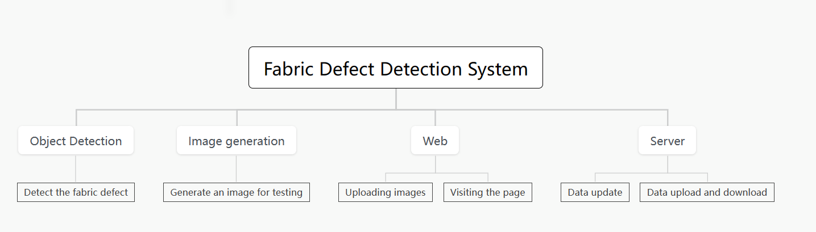

System structure diagram

Slide 9
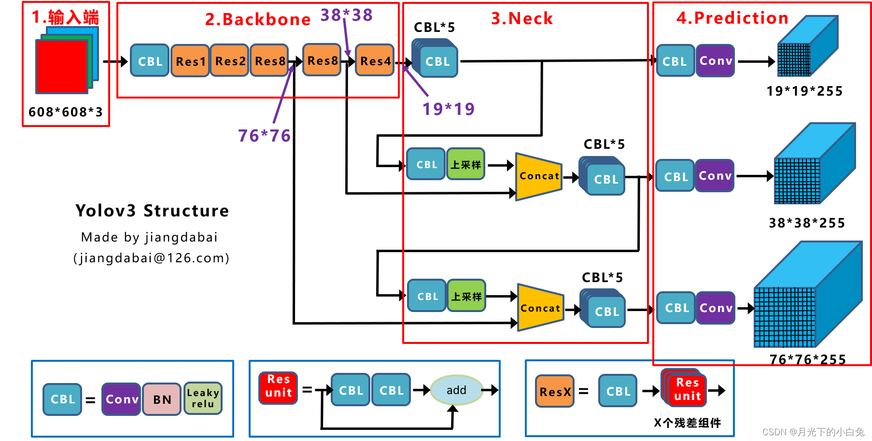
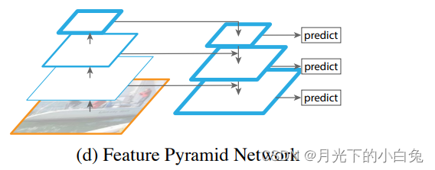
Main model
The most important function of this system is to realize the object detection module.This system uses the object detection module to detect fabric defects. The model used in the object detection module is yolov3.
Yolov3 Structure
Yolov3 model is a very traditional but classic model in the field of object detection. The model mainly consists of three parts, namely Darknet-53 backbone network and its residual network, feature fusion layer (concat) and the final classification and detection structure.

Slide 10
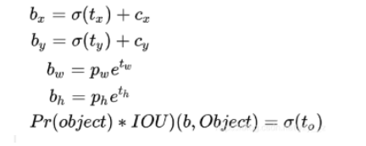
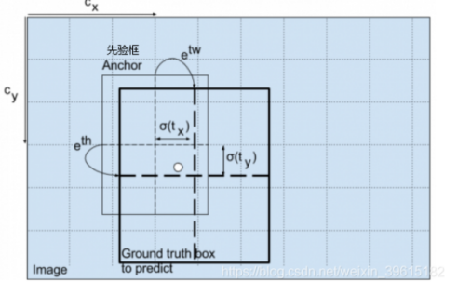
Main model
Depending on the size of the defect, the feature layer is used, which produces red boxes. Next, the prediction results need to be decoded. The predicted red box generated by the feature layer is calculated to obtain the coordinates of the bounding box bx,by and the position of the bounding box. The calculation process is as follows.
Decoding of predicted results
The calculation process is as follows. The boxes and scores of each class whose score is greater than a certain threshold are taken out and sorted. Non-maximal suppression is performed using the position and score of the box. The final bounding box with the highest probability is the one that is displayed last.

Slide 11
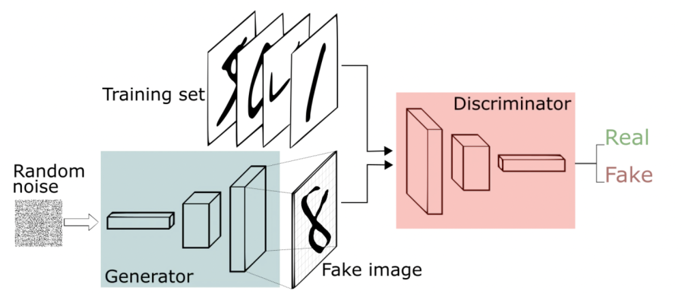
Secondary model
In this system, 2K resolution high-definition images are used to train the object recognition model, but in practical application scenarios, many images cannot achieve 2K resolution, so we need to use low-quilty fabric images to test the model, but we lack a low-quilty image dataset, so we propose a solution: A generative network is used to generate fake and low-quality images. At the same time, for users who want to use the system but can not upload pictures for various reasons, the system can generate a picture for testing.

Slide 12
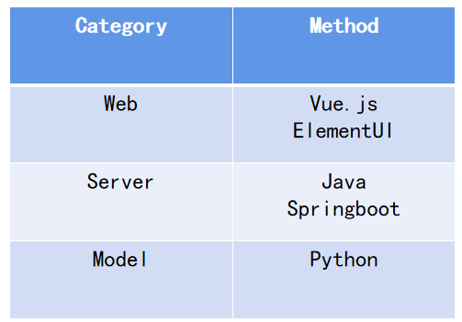
System
This system needs a carrier to display the prediction and generated results of the model, so we choose to develop a webapp with B/S architecture to display the prediction and generated results. The B/S architecture is chosen because the current mainstream webapp is this architecture, and users only need to use a browser to access our website to obtain services, which greatly improves the user experience.

Slide 13
System
The front-end of this system is implemented by Vue.js, which is a Javascript framework for building user interfaces. It is built based on HTML,CSS and Javasccript, and provides a set of declarative and component-based programming models to help users develop user interfaces efficiently.
The system back-end is written in java, and Springboot is used to build the whole back-end project. Spring Boot is a new framework from the Pivotal team that's designed to simplify the initial process of building and developing Spring applications. The framework uses a specific way to do configuration so that the developer does not need to define boilerplate configuration. In this way, SpringBoot aims to be a leader in the burgeoning field of rapid application development.

Slide 14
03
Project development plan

Slide 15
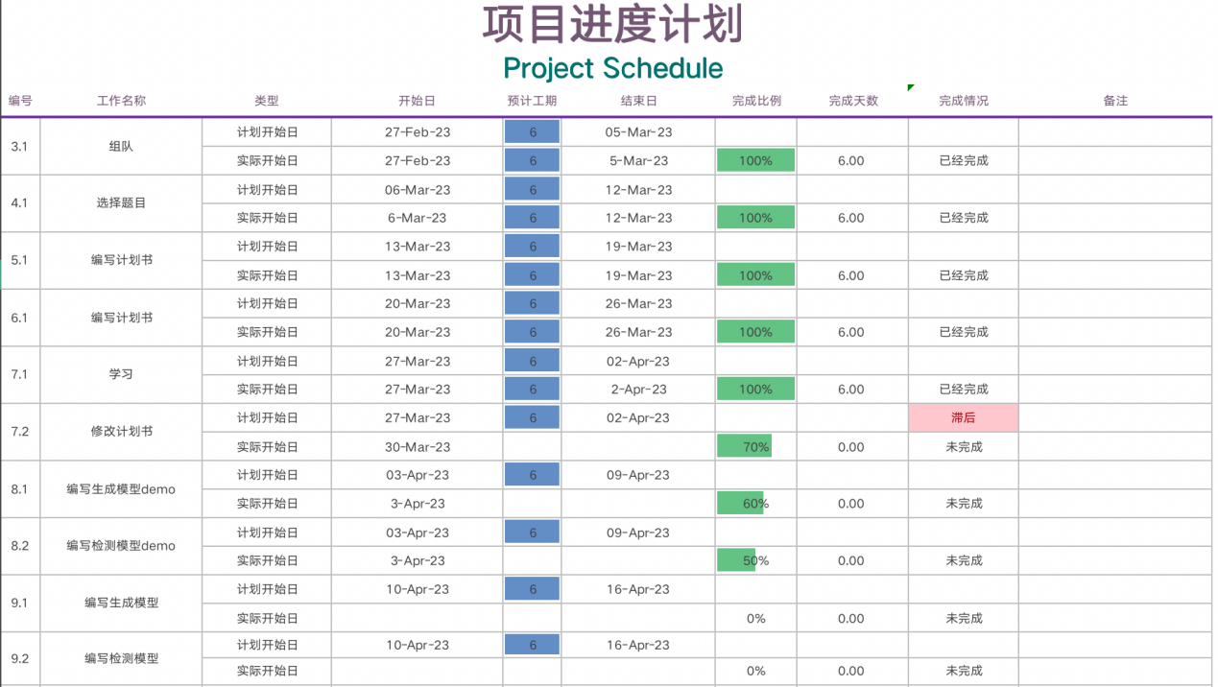
Project schedule
This section mainly introduces the schedule of the whole project, and gives the project schedule and Gantt chart. The specific content is shown in the figure below.

Slide 16
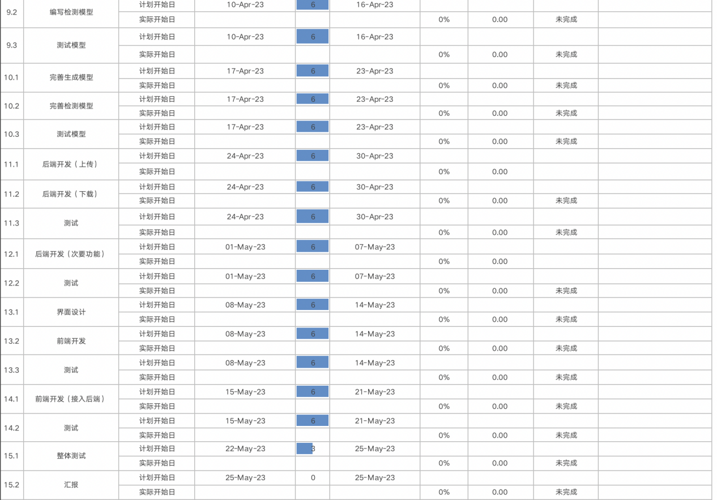
Project schedule

Slide 17
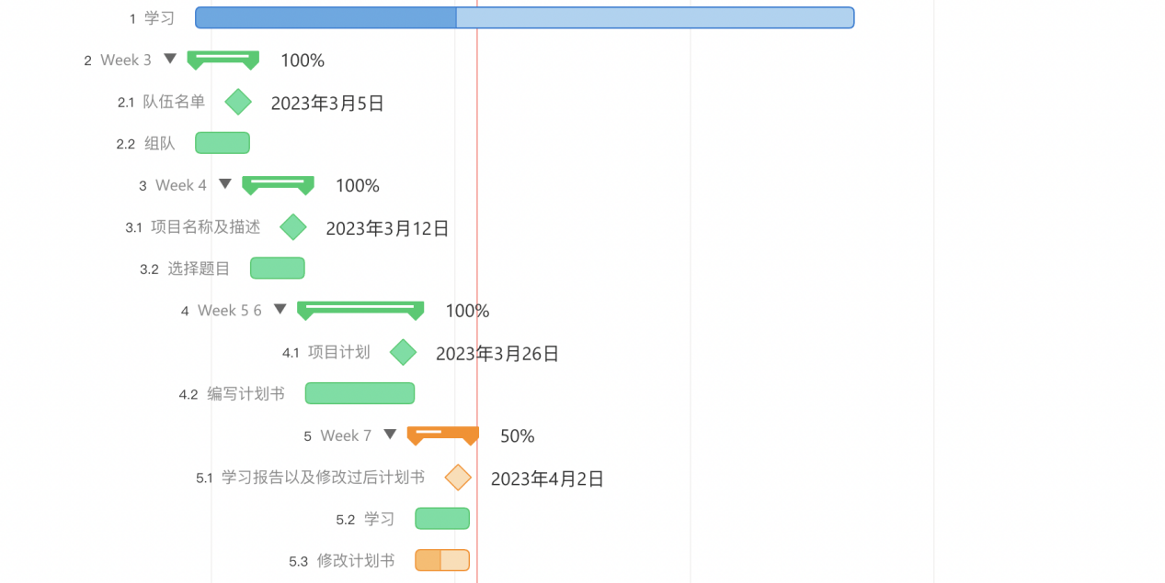
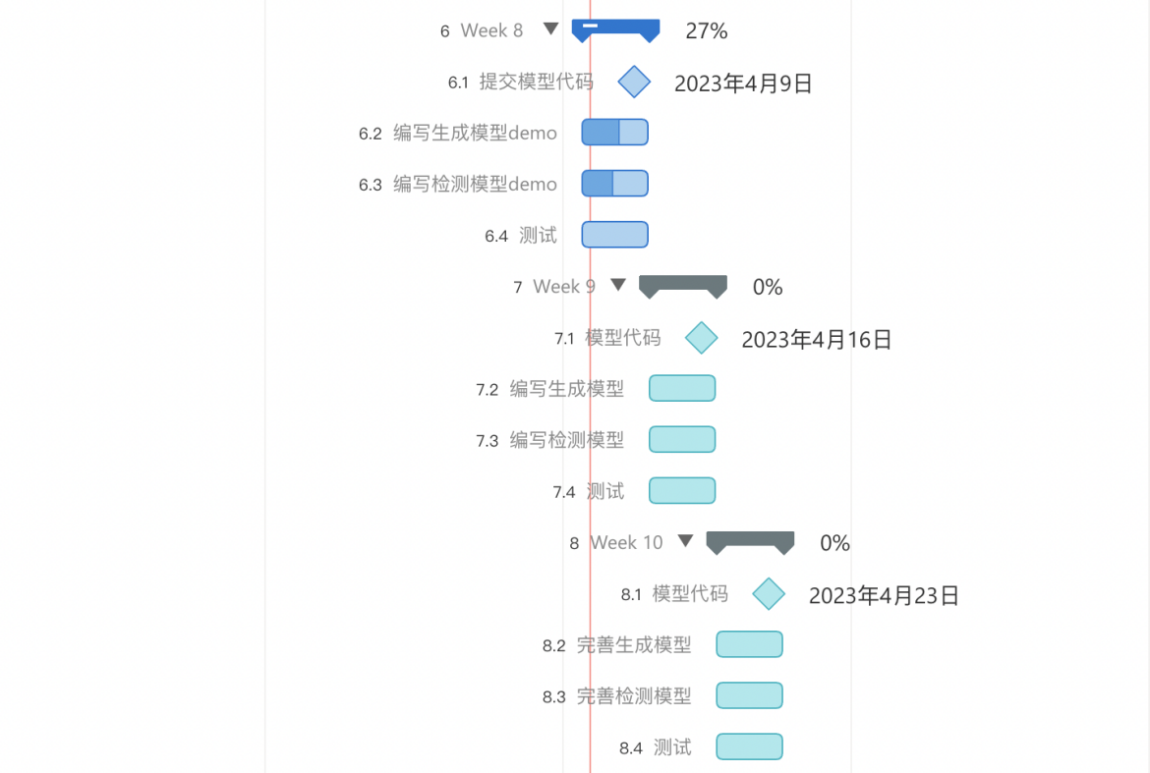
Project schedule

Slide 18
Mile Stone
sprint 1
Time | Milestone | Description
Sprint 1
Week3 | Teamleadersubmits team list.
Week 4 | Team leader submits the project and a brief description on the online document.
Week 5 Week 6 | Team leader submits the project plan | Team leader submits the project plan at week 7.
Week 7 | Everyone must submit a report about what you have learned in this week.
Week 8 | The member who is responsible for the model submits a demo. | The demo must be runnable and the member must submit the outcome of the demo.The other members should submit their own work in this week.
Week 9 | The member who is responsible for the model submits the model. | The model is used to solve most of the real problem we proposed.The model contains of souce code ,the parameter and outcome.The other members should submit their own work in this week.
Week 10 | The member who is responsible for the model submits the complete model. | The model is used to solve all of the real problem we proposed.The model contains of souce code ,the parameter and outcome.The other members should submit their own work in this week.

Slide 19
Mile Stone
sprint 2
Sprint2
Week 11 Week 12 | The member submits the module of the server. | The module can be used to solve the corresponding requirement.The other members should submit their own work in this week.
Week 13 Week 14 | The member submits the module of web page. | The module can be used to solve the corresponding requirement.The other members should submit their own work in this week.
Week 15 | The teams submit the system. | The team give the presentation of the system.

Slide 20
04
Project Team Organization

Slide 21
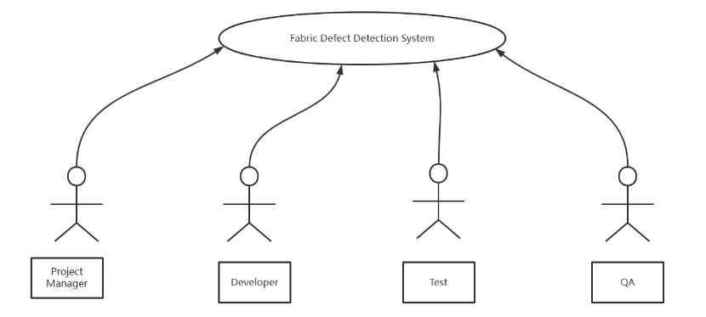
Character
Project Manager(PM, 1 person): The project manager is responsible for coordinating the planning and execution of the project to ensure the smooth and active operation of the team.
Developer(2 person): Responsible for the development of the web and server of the system and the construction of the model.
Test(1 person) : The tester is responsible for testing the various modules of the system.
Quality Assurance (QA, 1 person) : A quality assurance engineer tests the product to ensure that it meets standards and customer expectations.

Slide 22
Organization Structure
Name | Character
Yichen Xie | Developer，Test (or PM)
Yuchen Song | Developer, QA (or PM)
Lu Lu | Test, QA (or PM)
Duohan Xu | QA, Developer (or PM)
The project called “fabric-defect-detection system” is developed by our team. In terms of the organization structure of the team, it’s not fixed but everone has his main character.
There are four members in the team, in different periods of development, members with relatively less task will become project managers to organize and supervise the progress of the project, so as to ensure the project can be completed .

Slide 23
05
Project Risk

Slide 24
Project Risks
During the execution of the project, it is inevitable that there will be various kinds of accidents, which may lead to the failure of the whole project. Therefore, we must put forward all possible accidents in the plan, and propose corresponding solutions for these accidents.
Risk Type | Risk | Impact | Solution
schedule risk | Unable to complete due to time constraints.The project plan may faces delays. | High | Membershould fully consider various potential factors and make plans.Breakdown of tasks should be indetail.Members should strictly follow the project plan,.
Technical risks | Team is unable to builda robust model due to hardware performance.Team chooses a wrong model that can’t solve the problem proposed. | High | The performance of the model can be allowed to be weak，but it must be able to complete corresponding tasks.
Human Resources Risk | Members cannot complete this week's task due to special reasons. | Low | Members need to notify other members in advance, and other membersare responsible for completing the module.

Slide 25
Project Risks
Requirement Risk | Thereare imperfections in the requirements presented, resulting in the need to change the requirements and revise the overall plan. | Medium | Team members need to inform the project manager of the new requirement, and the project manager will organize a meeting to discuss whether to add the new requirement. If all team members agree, the new requirement will be added.
ManagementRisk | The difference in the ability and level of the project management team brings uncertainty risk to the project construction. These management capabilities and levels include: the preparation and implementation of project schedule plan, the ability to plan and manage project human resources, the ability to manage project change, the ability to manage project communication, and the ability to manage project risk. | High | Each team member needs to be familiar with project management and keep learning.At the same time, it is necessary to strengthen communication. When there is any problem, it is necessary to inform the project manager, and then the project manager organizes a meeting to discuss.

Slide 26
Thank you for your watching!

